Slide 1

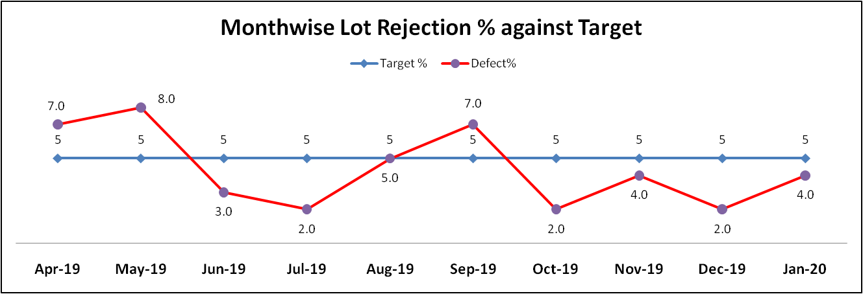
IQC
S.No | Month | Supplier | Item | Reason of Lot Defect | Action Taken
1 | Apr-19 | OEGPL Delhi | 1- Polybag 2- Back Cover S Pump 3- Air Cooler Blade | 1- Short in Length(Polybag) 2- Short Mould (Pump Cover) 3- Breakage (Cooler Blade) | 1- Lot Rejected, Communicated to supplier, OK Size material provided by supplier 2- Lot Seggregated, Communicated to supplier, PDI implementation at supplier end 3- Lot Rejected, Material issues at supplier end.
2 | Apr-19 | Garg Enterprises Delhi | Inlet Outlet Pipe Sleeve Amica | Flushes at mouth | Correction done by supplier in Mould
3 | Apr-19 | OEGPL D 255 | CRC Body 15 & 25 Amica | Water Mark on body | Additional Dryer installed by supplier in Paint Shop
4 | May-19 | OEGPL D 255 | CRC Body 15 Amica | colour variation & Pin hole | Additional Cleaning process at welding overlap started by supplier
5 | Sep-19 | OEGPL D255 | Leg & Body Amica | Leg & Body Colour mismatch | Temperature control variation, corrected at supplier end
Prepared By:-
Reviewed By:-
Approved By:-

Slide 2
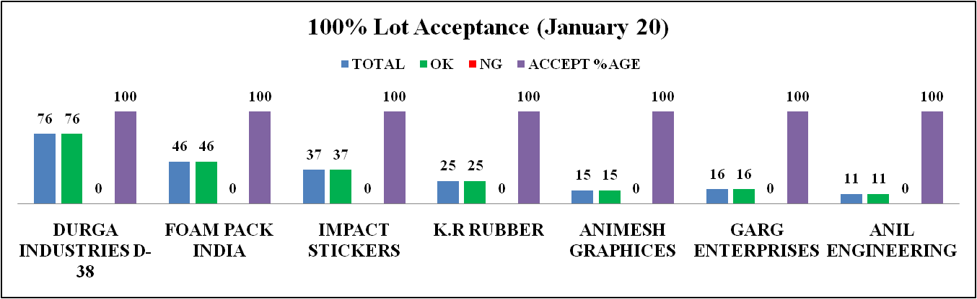
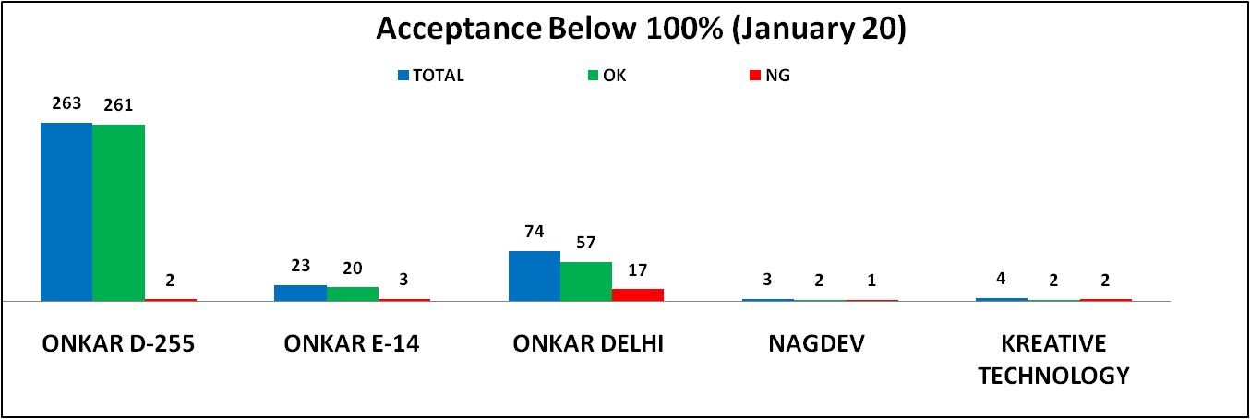
IQC
Prepared By:-
Reviewed By:-
Approved By:-

Slide 3
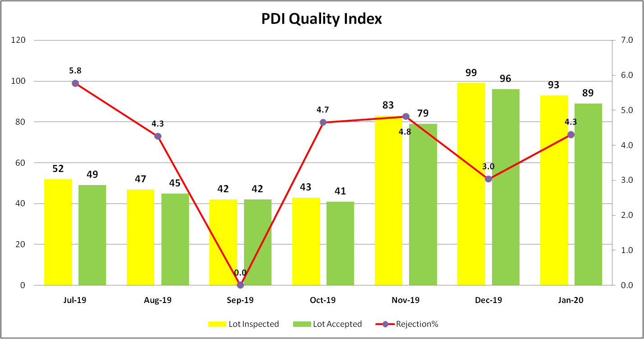
PDI
Prepared By:-
Reviewed By:-
Approved By:-

Slide 4
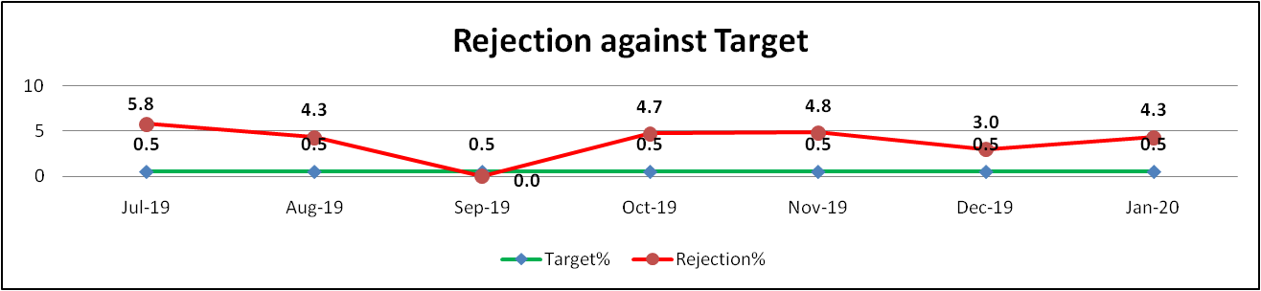
PDI Trend Against Target
Month | Reason of Lot Rejection | Action taken | Remarks
Oct-19 | Qube 25 Liter 1- Uneven Gap 2- Scratches 3- PUF Overflow | 1- Rib strengthen of bottom Cover 2- Handling improvements done at assembly line. 3- Glass wool attached with neck Ring
Nov-19 | Qube 25 Liter 1- Uneven Gap 2- Scratches 3- PUF Overflow 4- Rating Level wrong | 1- PUF Mould die Rectification 2- Glass wool dia reduced to 100 mm 3- Handling improvements done at assembly line 4- PUF curing time record for proper curing 5- FG rechecked for wrong rating level
Dec-19 | 15 & 25 AMICA 1- Rating label interchange 2- PCM body cleaning, poly bag warping particles, paint peel off at beading | 1- FG rechecked & segregated wrong one 2- PCM poly wrapping cleaned properly before PUF 3- Fabrication set up redesigned for paint peel off 4- Properly cleaning assurance at final check point
Jan-20 | 15 AMICA 1- Energy Saving Sticker pasted of last year 25 QUBE 1- PUF Puncture 2- Scratches on Body 3- Color variation in Top & Bottom | 15 AMICA 1- FG rechecked & segregated wrong one. 25 QUBE 1- FG rechecked & segregated
Prepared By:-
Reviewed By:-
Approved By:-

Slide 5
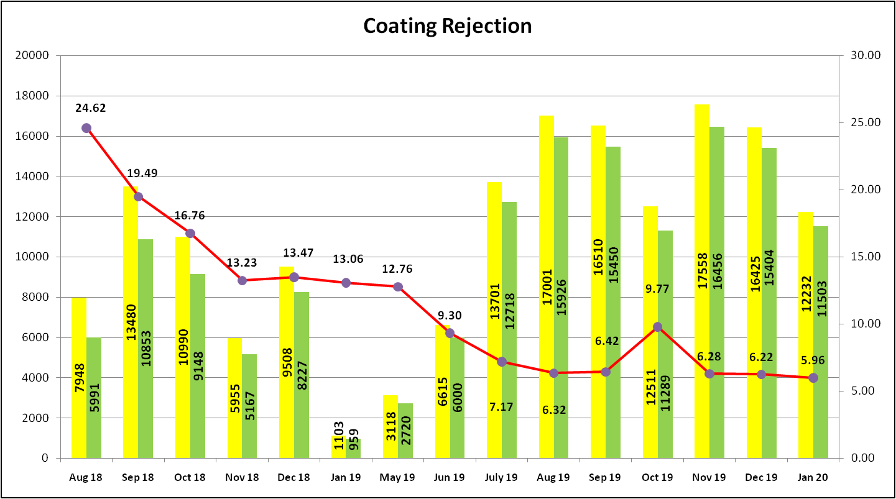
Process Rejection Trend Tank Coating
Prepared By:-
Reviewed By:-
Approved By:-

Slide 6
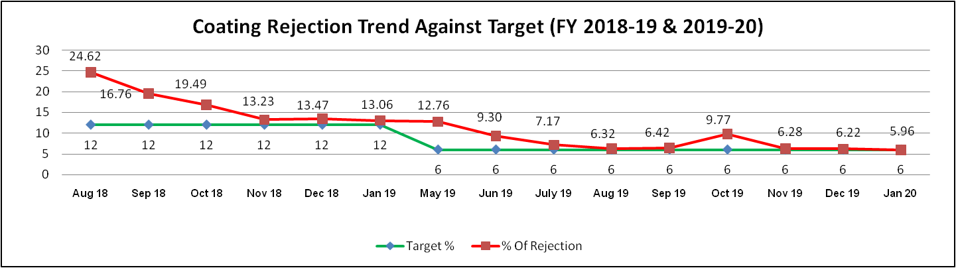
Process Rejection Trend Tank Coating
Month | Causes of Rejection Hike | Action against the causes
Aug-18 | 1- Untrained Manpower 2- Pretreatment uncontrolled | 1- Proper Training provided to manpower 2- Proper Titration arrangement & check on daily basis.
Sep-20 | 1- Frequent breakdowns in machineries 2- Tank alignment improper at pretreatment & Coating | 1- Breakdown down maintenance only due to running Production 2- Clamping arrangement at pretreatment & Coating
Oct-18 | 1- Sensors malfunctioning 2- Pretreatment spray nozzle misalignment / Choked | 1- Repaired after detection 2- Depute manpower for 100% Controlling
Feb 19 to April 19 | Preventive Maintenance of Plant | 1- All the sensors & Panels Properly covered 2- Pretreatment Clamping System changed 3- Spares Arrangement 4- Pretreatment covered with transparent sheet 5- All the Control panels properly covered to avoid the dust 6- Shot blasting Inspection set up
Oct-19 | 1- Improper Pretreatment 2- Overhead conveyor breakdown | 1- 100% inspection after Pretreatment 2- Temporary maintenance due to running Production
Prepared By:-
Reviewed By:-
Approved By:-

Slide 7
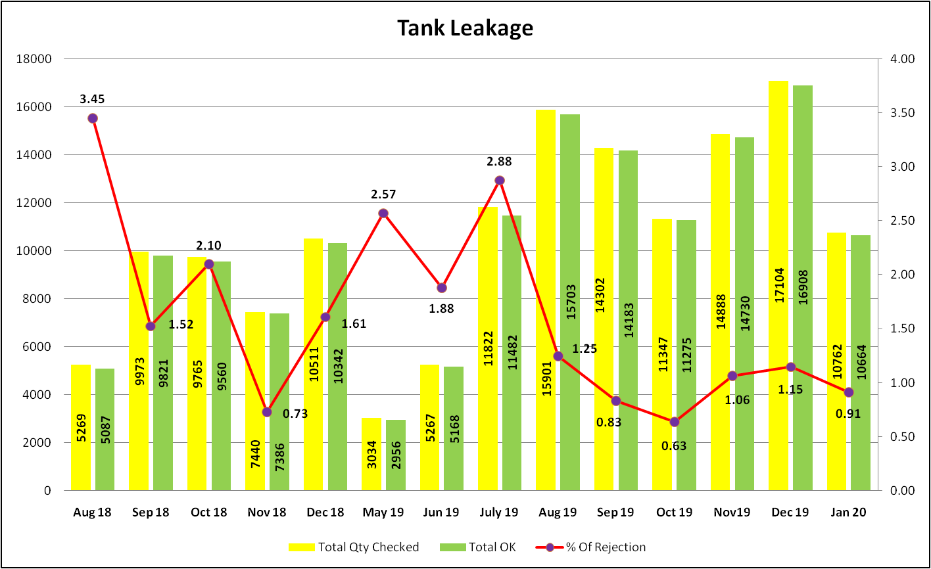
Process Rejection Trend Tank Leakage
Prepared By:-
Reviewed By:-
Approved By:-

Slide 8
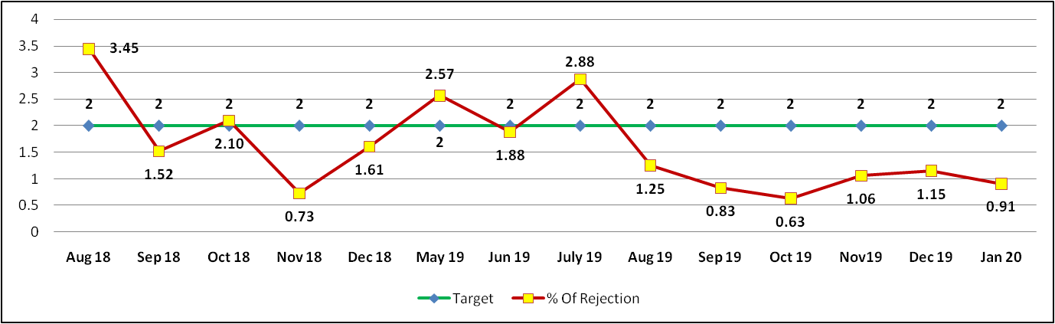
Process Rejection Trend Tank Leakage
Month | Causes of Rejection Hike | Action against the causes
Aug-18 | Leakage from Thermostat & Cutout pocket of Element | Modification done in leakage testing set up at supplier end
May-19 | Leakage From Element Connection Pin | Communicated to supplier. Brazing Process of Element improved.
Jul-19 | Element wrongly send by the supplier without leakage Test | Communicated to supplier. Proper arrangement/ separation of FG with WIP
Prepared By:-
Reviewed By:-
Approved By:-

Slide 9
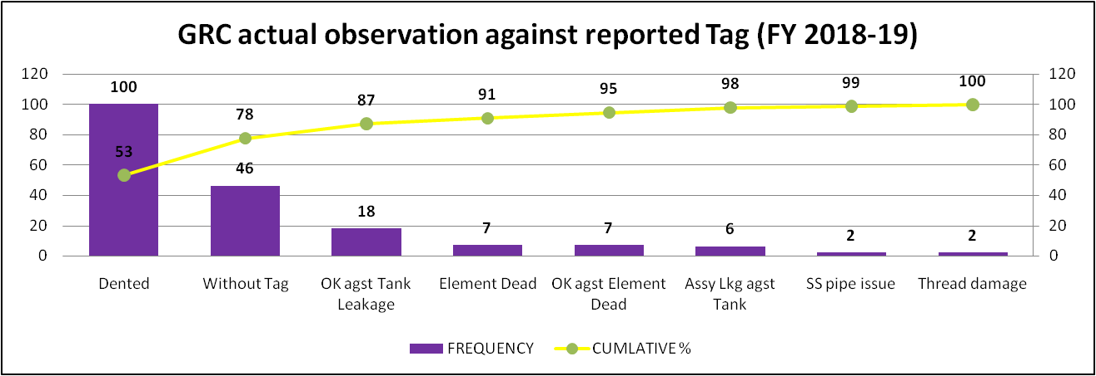
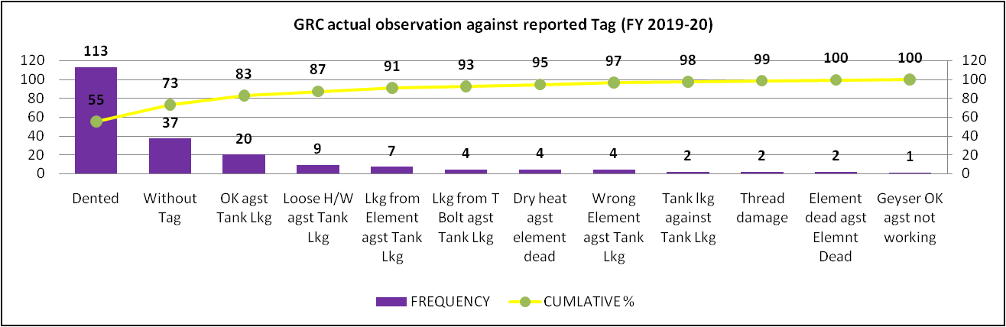
Field Complaint V/S In house Market Complaint Analysis
Prepared By:-
Reviewed By:-
Approved By:-

Slide 10
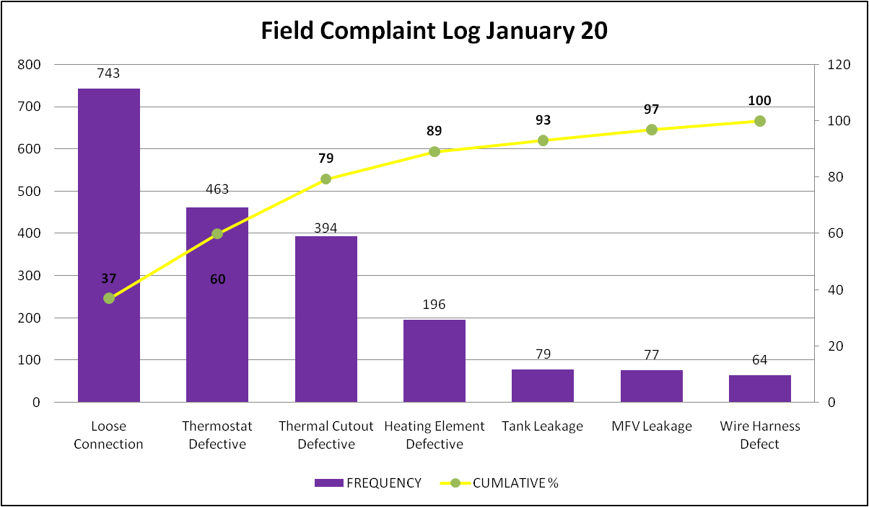
Field Complaint Log
Prepared By:-
Reviewed By:-
Approved By:-

Slide 11
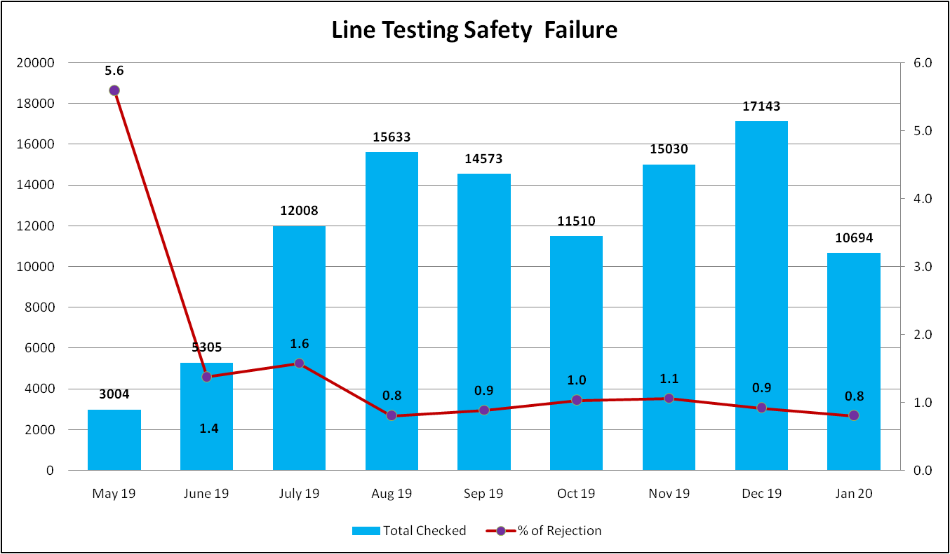
Line Testing Safety Failure Rejection
Prepared By:-
Reviewed By:-
Approved By:-

Slide 12
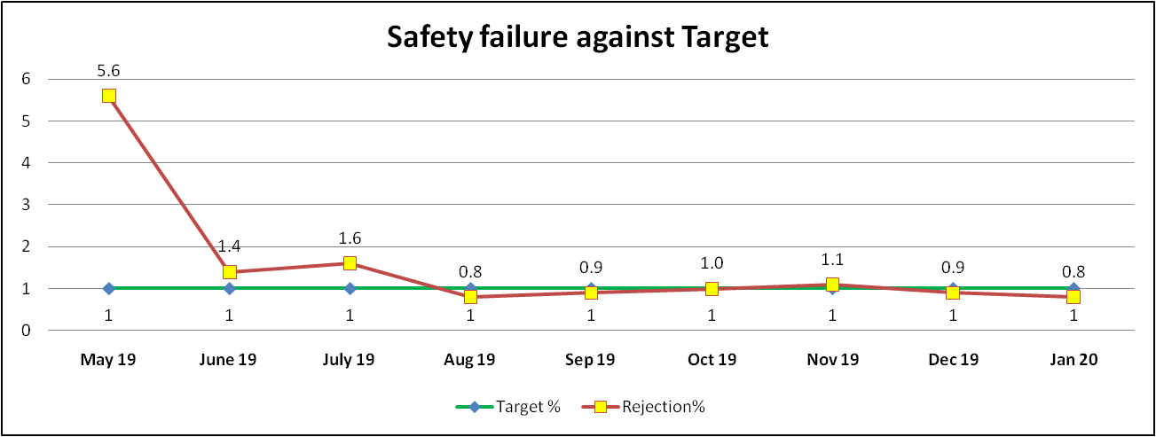
Line Testing Safety Failure Rejection
Month | Causes of Rejection Hike | Action against the causes
May-19 | Moisture absorbed by the Element after leakage Testing | Communicated to supplier. Element deep in water before Final Testing at supplier End
Jun-19 | Over torque in element during Connection | Low Torque gun provided at connection
Jul-19 | Moisture absorved by the Element after leakage Testing | Communicated to supplier. Deeping time increase 30 minutes to an hour for rainy season
Prepared By:-
Reviewed By:-
Approved By:-

Slide 13
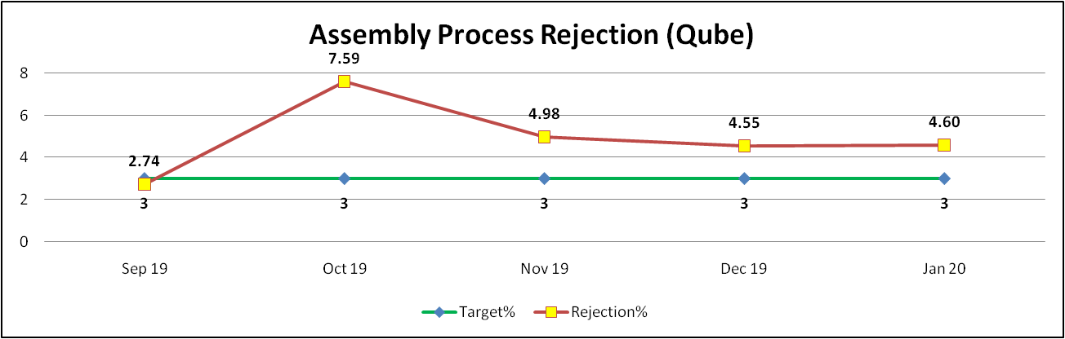
Assembly Line Process Rejection
Month | Causes of Rejection Hike | Action against the causes
Oct-19 | 1- Plastic Body Rejection due to PUF Overflow (15 Liter) 2- Gap in Top & Bottom | 1- Correction in Body as well as PUF Mould 2- Strengthen the Rib of Bottom Cover
Nov-19 | 1- Plastic Body Rejection due to PUF Overflow (25 Liter) 2- Gap in Top & Bottom | 1- further Correction done in Body as well as PUF Mould 2- PUF curing time increased by 7 minutes to 12 minutes
Dec-19 | 1- Plastic Body Rejection due to PUF Overflow (25 Liter) | 1- Addition of glass wool at all possible holes
Jan -20 | 1- Scratches in Body 2- Power Cord Pin Dent 3- PUF puncture | 1- Handling improvement in plastic components 2- Communicated to supplier. All stock segregated. 3- New Stopper under development to avid the PUF leakage from Mounting clamp area
Prepared By:-
Reviewed By:-
Approved By:-

Slide 14
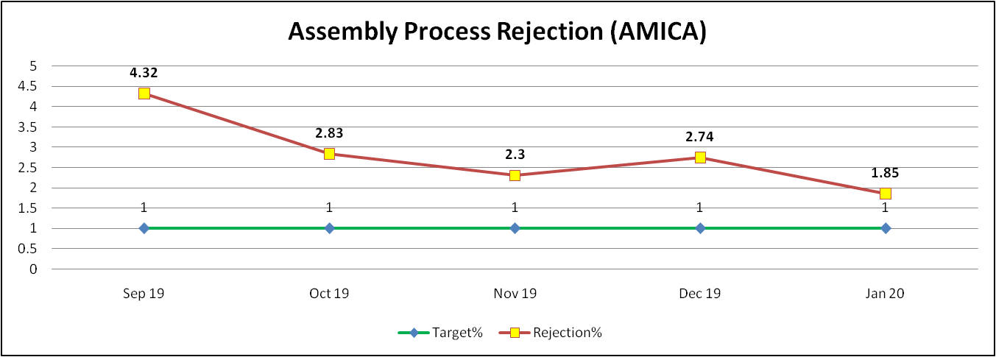
Assembly Line Process Rejection
Month | Causes of Rejection Hike | Action against the causes
Oct-19 | Plastic parts molding defects like silver streaks & color variation | Run after segregation. Mould rectified
Nov-19 | Transportation Dent in CRC body | Long vehicle strictly prohibited for transportation of body
Dec-19 | PCM sheet introduced | All the fabrication issues resolved at supplier end
Jan - 20 | PCM Sheet Dented after PUF Mould near mounting leg | Bolt tightening over. Corrected the same at Leg assembly
Prepared By:-
Reviewed By:-
Approved By:-

